Slide 1
CHAPTER 17
Indexing Structures for Files and Physical Database Design

Slide 2
Introduction
Indexes used to speed up record retrieval in response to certain search conditions
Index structures provide secondary access paths
Any field can be used to create an index
Multiple indexes can be constructed
Most indexes based on ordered files
Tree data structures organize the index

Slide 3
17.1 Types of Single-Level Ordered Indexes
Ordered index similar to index in a textbook
Indexing field (attribute)
Index stores each value of the index field with list of pointers to all disk blocks that contain records with that field value
Values in index are ordered

Slide 4
Types of Single-Level Ordered Indexes (cont’d.)
Primary index
Specified on the ordering key field of ordered file of records
Clustering index
Used if numerous records can have the same value for the ordering field
Secondary index
Can be specified on any nonordering field
Data file can have several secondary indexes

Slide 5
Primary Indexes
Ordered file with two fields
Primary key, K(i)
Pointer to a disk block, P(i)
One index entry in the index file for each block in the data file
Indexes may be dense or sparse
Dense index has an index entry for every search key value in the data file
Sparse index has entries for only some search values

Slide 6
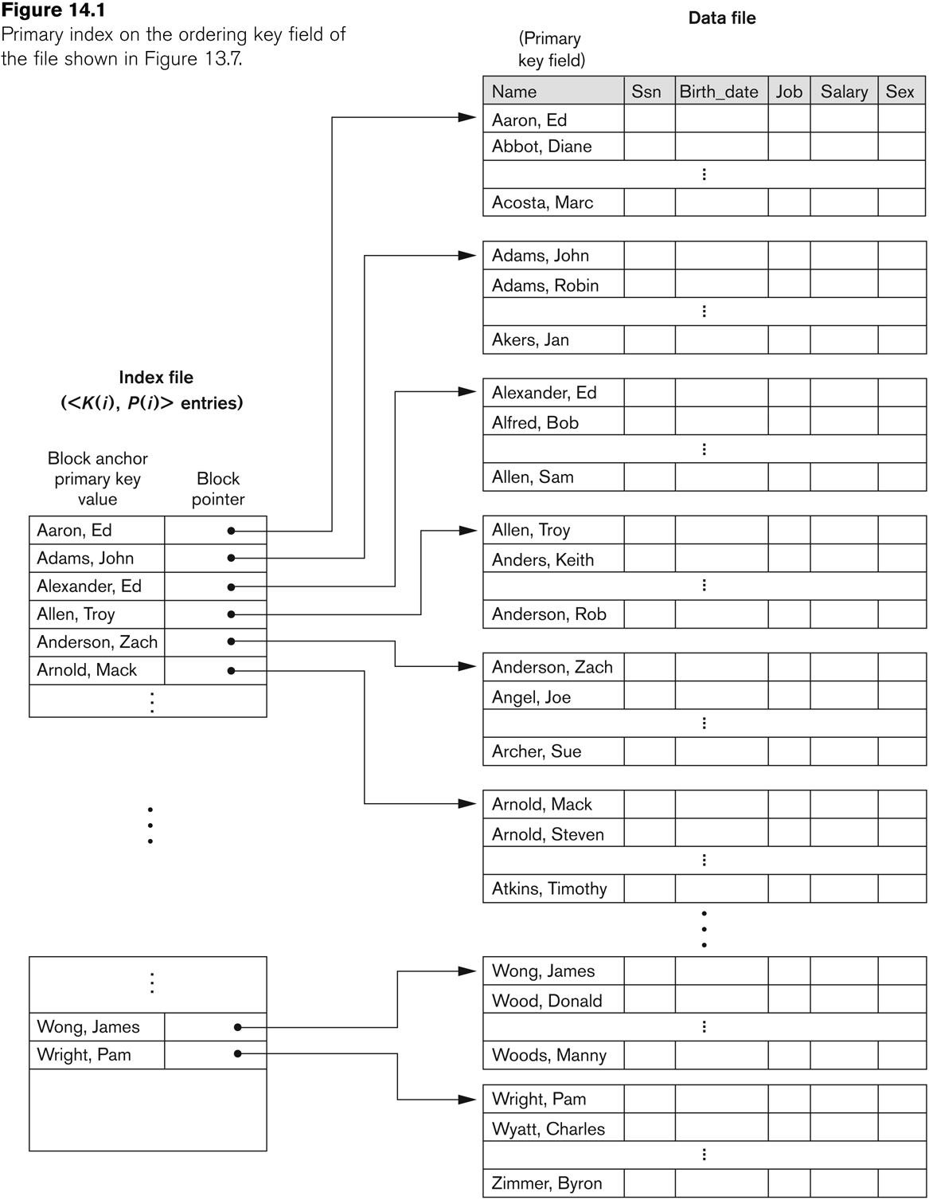
Primary Indexes (cont’d.)
Figure 17.1 Primary index on the ordering key field of the file shown in Figure 16.7

Slide 7
Primary Indexes (cont’d.)
Major problem: insertion and deletion of records
Move records around and change index values
Solutions
Use unordered overflow file
Use linked list of overflow records

Slide 8
Clustering Indexes
Clustering field
File records are physically ordered on a nonkey field without a distinct value for each record
Ordered file with two fields
Same type as clustering field
Disk block pointer

Slide 9
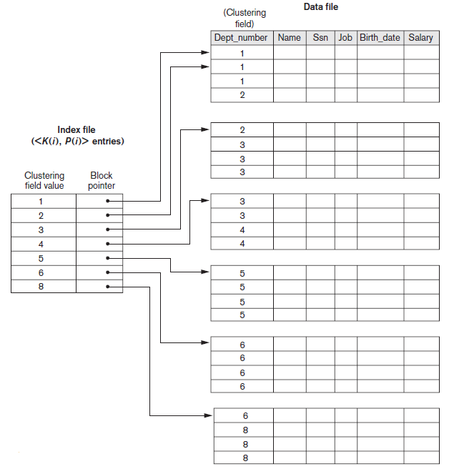
Clustering Indexes (cont’d.)
Figure 17.2 A clustering index on the Dept_number ordering nonkey field of an EMPLOYEE file

Slide 10
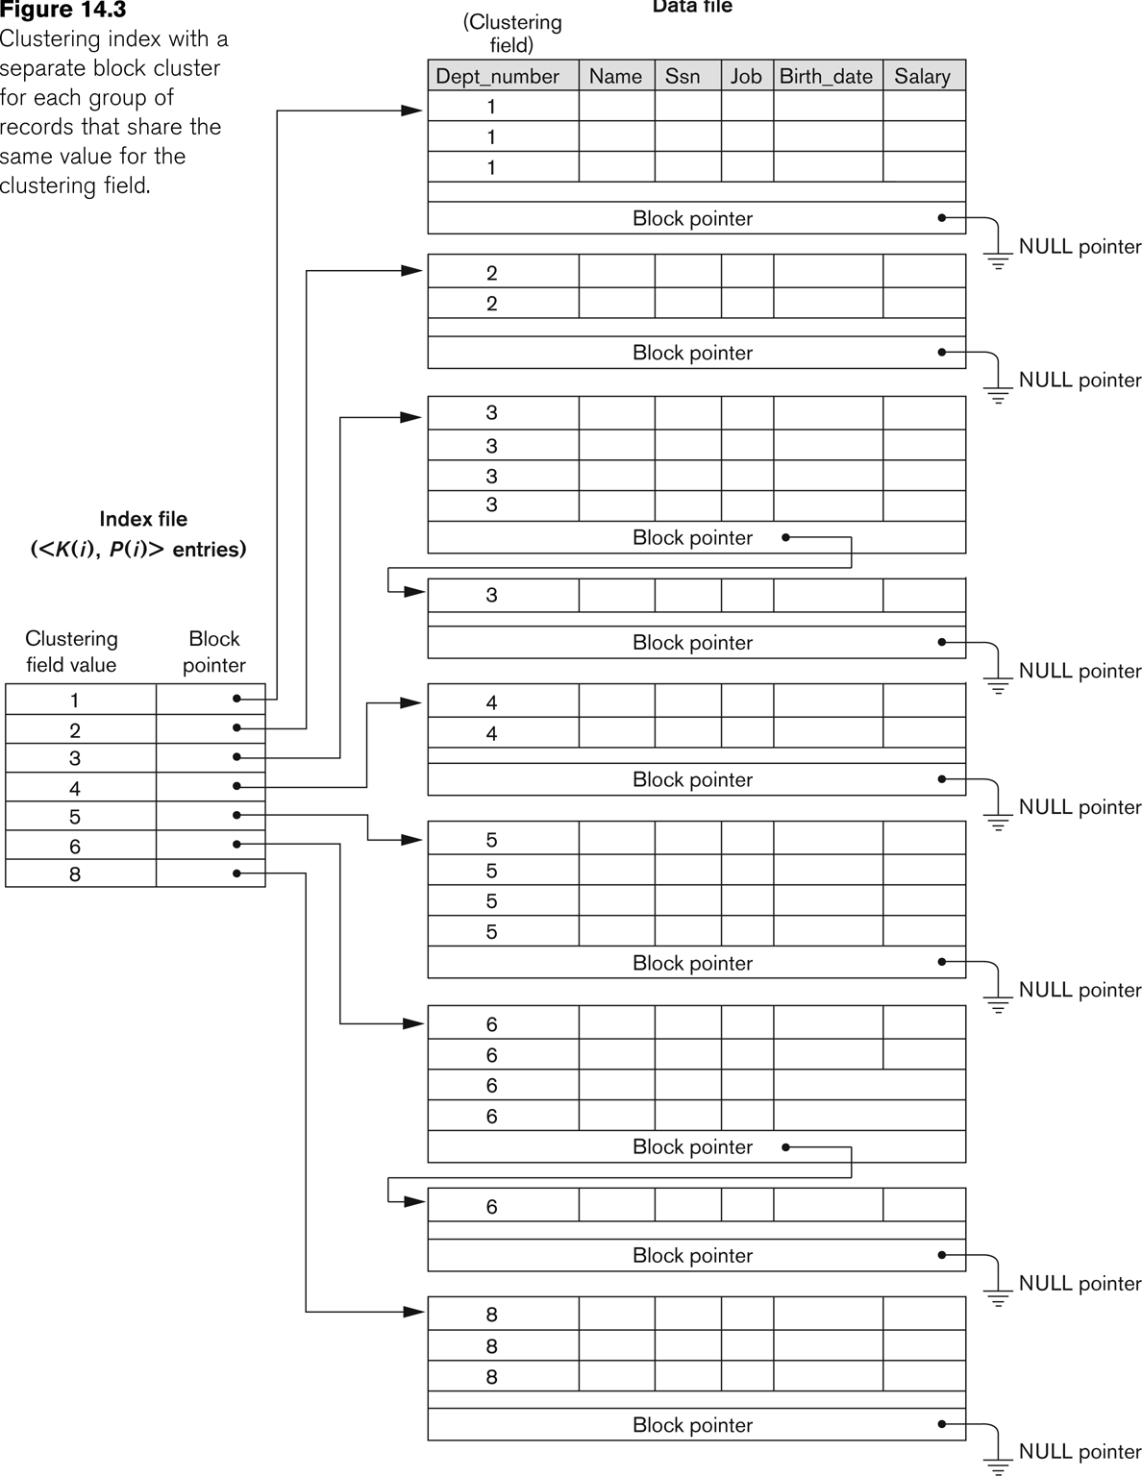
Clustering Indexes (cont’d.)

Slide 11
Secondary Indexes
Provide secondary means of accessing a data file
Some primary access exists
Ordered file with two fields
Indexing field, K(i)
Block pointer or record pointer, P(i)
Usually need more storage space and longer search time than primary index
Improved search time for arbitrary record

Slide 12
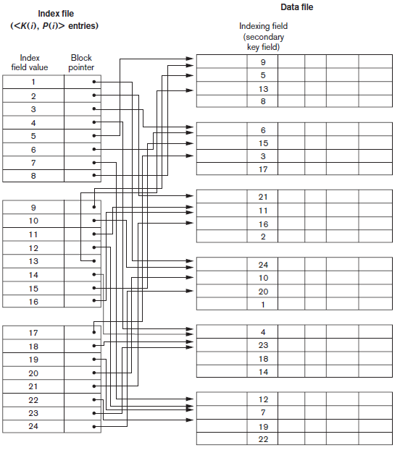
Secondary Indexes (cont’d.)
Figure 17.4 Dense secondary index (with block pointers) on a nonordering key field of a file.

Slide 13
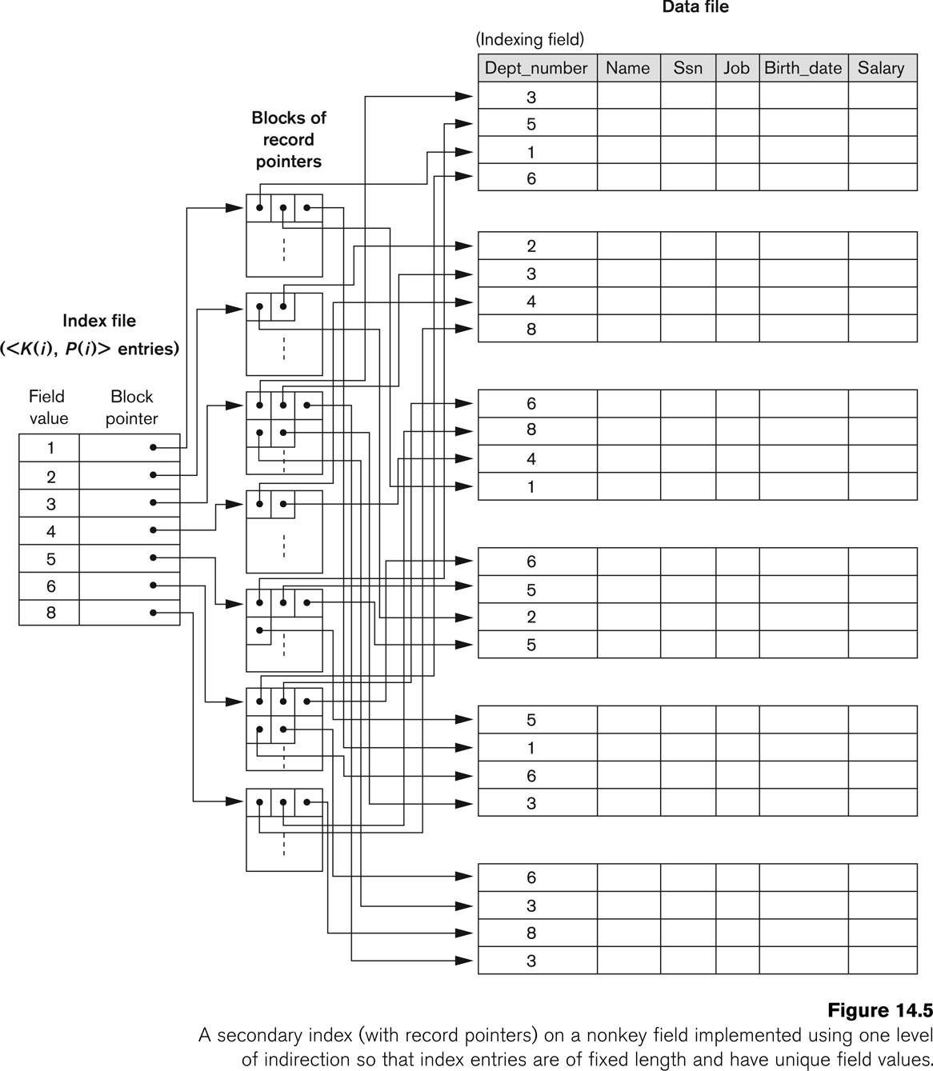
Secondary Indexes (cont’d.)

Slide 14
Secondary Index Cluster Index

Slide 15
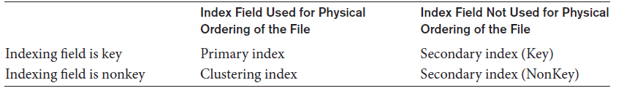
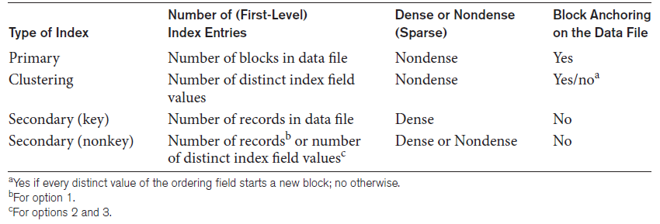
Types of Single-Level Ordered Indexes (cont’d.)
Table 17.1 Types of indexes based on the properties of the indexing field
Table 17.2 Properties of index types

Slide 16
Example: Indexes as Access Paths
Example: Given the following data file EMPLOYEE(NAME, SSN, ADDRESS, JOB, SAL, ... )
Suppose that:
record size R=150 bytes block size B=512 bytes r=30000 records
For an index on the SSN field, assume the field size V_{SSN}=9 bytes, assume the record pointer size P_{R}=7 bytes. Then find cost if:
A) File records are not ordered
B) File records are ordered on SSN

Slide 17
Example: Indexes as Access Paths
Example: Given the following data file EMPLOYEE(NAME, SSN, ADDRESS, JOB, SAL, ... )
Suppose that:
record size R=150 bytes block size B=512 bytes r=30000 records
Then, we get:
blocking factor bfr= B/R= 512/150= 3 records/block
number of file blocks b= (r/bfr)= (30000/3)= 10000 blocks
index entry size R_{i}=(V_{SSN}+ P_{R})=(9+7)=16 bytes
index blocking factor bfr_{i}= B/R_{i}= 512/16= 32 entries/block
number of index blocks b_{i}= (r/ bfr_{i})= (30000/32)= 938 blocks
Binary search (on Index) needs:
log₂b_{i}= log₂938 = 10 block accesses (Index Access Cost)
This is compared to linear search cost of:
(b) = 10000 block accesses
If the file records are ordered, the binary search cost would be:
log₂b= log₂10000= 15 block accesses

Slide 18
17.2 Multilevel Indexes
Designed to greatly reduce remaining search space as search is conducted
Index file
Considered first (or base level) of a multilevel index
Second level
Primary index to the first level
Third level
Primary index to the second level

Slide 19
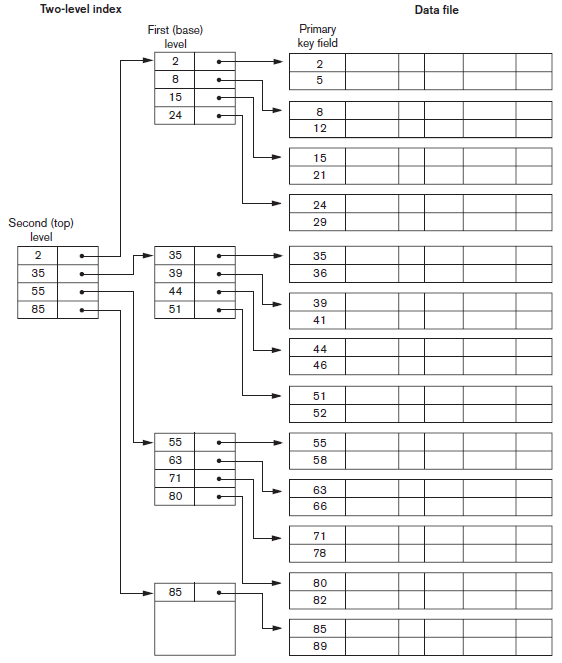
Figure 17.6 A two-level primary index resembling ISAM (indexed sequential access method) organization

Slide 20
17.3 Dynamic Multilevel Indexes Using B-Trees and B+ -Trees
Tree data structure terminology
Tree is formed of nodes
Each node (except root) has one parent and zero or more child nodes
Leaf node has no child nodes
Unbalanced if leaf nodes occur at different levels
Nonleaf node called internal node
Subtree of node consists of node and all descendant nodes

Slide 21
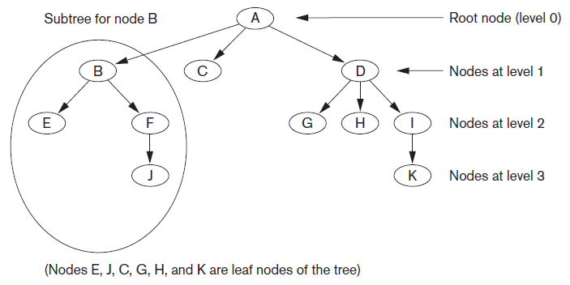
Tree Data Structure
Figure 17.7 A tree data structure that shows an unbalanced tree

Slide 22
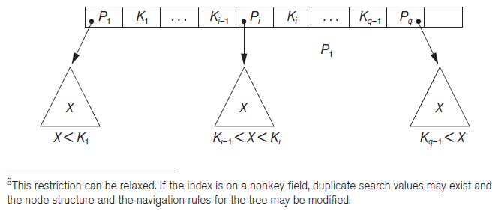
Search Trees and B-Trees
Search tree used to guide search for a record
Given value of one of record’s fields
Figure 17.8 A node in a search tree with pointers to subtrees below it

Slide 23
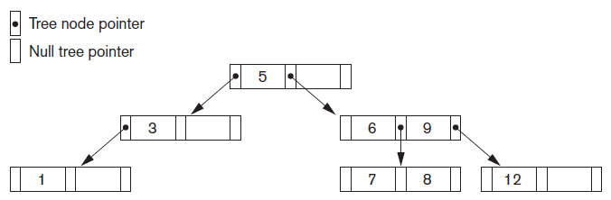
Search Trees and B-Trees (cont’d.)
Algorithms necessary for inserting and deleting search values into and from the tree
Figure 17.9 A search tree of order p = 3

Slide 24
B-Trees
Provide multi-level access structure
Tree is always balanced
Space wasted by deletion never becomes excessive
Each node is at least half-full
Each node in a B-tree of order p can have at most p-1 search values

Slide 25
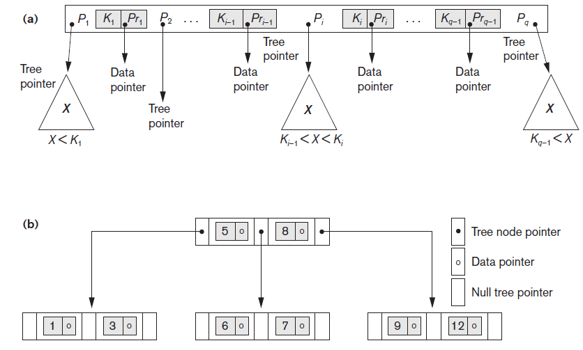
B-Tree Structures
Figure 17.10 B-tree structures (a) A node in a B-tree with q−1 search values (b) A B-tree of order p=3. The values were inserted in the order 8, 5, 1, 7, 3, 12, 9, 6

Slide 26
B+ -Trees
Data pointers stored only at the leaf nodes
Leaf nodes have an entry for every value of the search field, and a data pointer to the record if search field is a key field
For a nonkey search field, the pointer points to a block containing pointers to the data file records
Internal nodes
Some search field values from the leaf nodes repeated to guide search

Slide 27
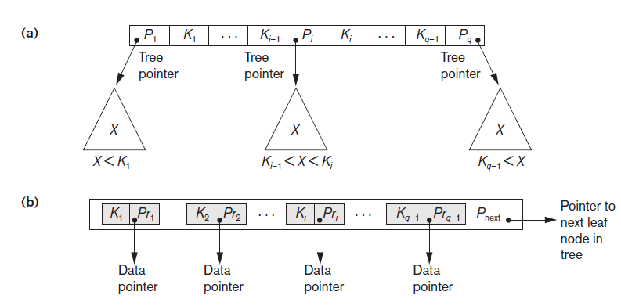
B+ -Trees (cont’d.)
Figure 17.11 The nodes of a B+-tree (a) Internal node of a B+-tree with q−1 search values (b) Leaf node of a B+-tree with q−1 search values and q−1 data pointers

Slide 28
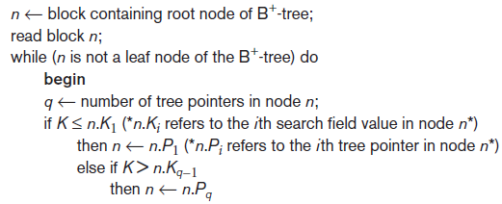
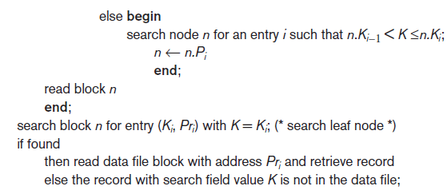
Searching for a Record With Search Key Field Value K, Using a B+ -Tree
Algorithm 17.2 Searching for a record with search key field value K, using a B+ -Tree

Slide 29
17.4 Indexes on Multiple Keys
Multiple attributes involved in many retrieval and update requests
Consider the query: List the employees in Dno 4 whose Age is 21 (both columns are non-unique).
Search strategies:
- Assuming Dno has an index, but Age does not
- If Age is indexed but Dno is not
- If indexes have been created on both Dno & Age
Composite Index Types:
Ordered Index, Partitioned Hashing, Grid Files

Slide 30
Indexes on Multiple Keys (cont’d.)
Ordered Index on Composite keys
Access structure using key value that combines attributes
Search keys are stored in sorted order
Suitable for range queries

Slide 31
Indexes on Multiple Keys (cont’d.)
Partitioned hashing
Is an extension of static external hashing that allows access on composite keys
Search keys are distributed uniformly across ‘buckets’ by concatenation of n separate hash addresses
Suitable for equality comparisons Only

Slide 32
Indexes on Multiple Keys (cont’d.)
Partitioned hashing…
E.g. Consider the composite search key <Dno, Age>. If Dno and Age are hashed into a 3-bit and 5-bit address respectively, we get an 8-bit bucket address.
Suppose that Dno=4 has a hash address ‘100’ and Age=21 has a hash address ‘10101’.
Then to search for the combined search value, Dno=4 and Age=21, one goes to bucket address 100 10101;
Just to search for all employees with Age=21, all buckets (8 of them) will be searched whose addresses are ‘000 10101’, ‘001 10101’, …, ‘111 10101’

Slide 33
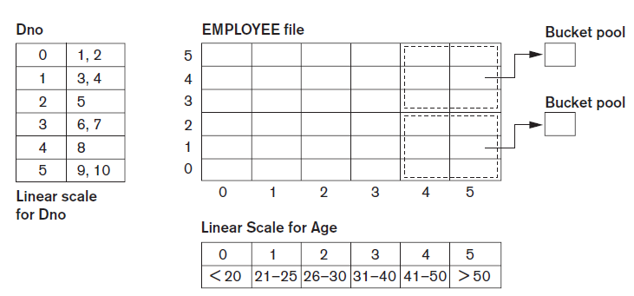
Indexes on Multiple Keys (cont’d.)
Grid files
Array with one dimension for each search attribute
Figure 17.14 Example of a grid array on Dno and Age attributes

Slide 34
Grid files
The grid file concept can be applied to any number of search keys. For example, for n search keys the grid array would have n dimensions.
Grid files perform well in terms of reduction in time for multiple key access.
However, they represent a space overhead in terms of the grid array structure.

Slide 35
17.5 Other Types of Indexes
Hash indexes
Bitmap Indexes
Function-Based Indexing

Slide 36
Hash Indexes
Secondary structure for file access
Uses hashing on a search key other than the one used for the primary data file organization
Index entries of form (K, P_{r}) or (K, P)
P_{r}: pointer to the record containing the key
P: pointer to the block containing the record for that key

Slide 37
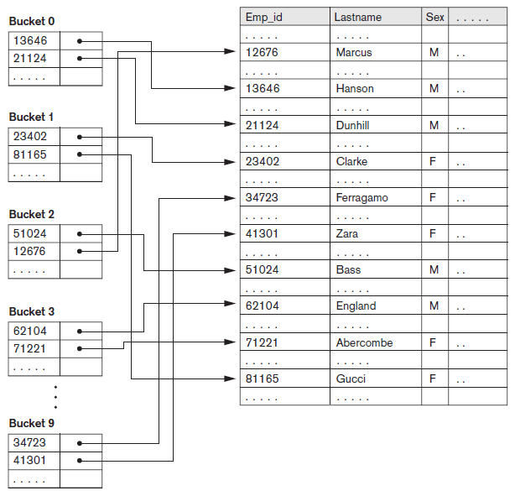
Hash Indexes - Example
h(f) = Sum of digits of Emp_id MOD 10

Slide 38
Bitmap Indexes
Used with a large number of rows
Useful for columns with a small no of distinct values
Creates an index for one or more columns
Each value (or value range) in the column is indexed
Built on one particular value of a particular field
Array of bits
(Each index contains n bits for a relation with n rows)
Existence bitmap
Bitmaps for B⁺-tree leaf nodes

Slide 39
Bitmap Indexes - Example
Row_id | Emp_id | Name | Sex | Marital Status | Salary | Bitmap Index
 |  |  |  |  |  | M | F | Married | Single | Divorced
0 | 51024 | Ahmad | M | Divorced | 9500 | 1 | 0 | 0 | 0 | 1
1 | 23402 | Ayesha | F | Single | 6500 | 0 | 1 | 0 | 1 | 0
2 | 62104 | Ali | M | Married | 8200 | 1 | 0 | 1 | 0 | 0
3 | 34723 | Sehar | F | Single | 6200 | 0 | 1 | 0 | 1 | 0
4 | 81165 | Maria | F | Married | 8500 | 0 | 1 | 1 | 0 | 0
5 | 13646 | Anwar | M | Married | 6600 | 1 | 0 | 1 | 0 | 0
6 | 12676 | Saeed | M | Single | 8800 | 1 | 0 | 0 | 1 | 0
7 | 41301 | Smeera | F | Divorced | 9200 | 0 | 1 | 0 | 0 | 1
Bitmap Index for Sex and Marital Status Columns

Slide 40

Function-Based Indexing
Value resulting from applying some function on a field (or fields) becomes the index key
Introduced in Oracle relational DBMS
Examples:
1
2
Queries:
CREATE INDEX income_ix
ON Employee ( Salary + (Salary * Commission_Pct ) );
Select First_name, Lname
FROM Employee
WHERE ((Salary*Commission_Pct) + Salary) >15000;

Slide 41
Outline
General issues concerning indexing
Logical vs Physical Indexes
Index Creation and Indexing of strings
Tuning Indexes
Additional issues related to storage of relations and indexes
Physical database design in relational databases
Factors that influence physical database design
Physical database design decisions

Slide 42
17.6 Some General Issues Concerning Indexing
Physical index
Pointer specifies physical record address
Disadvantage: pointer must be changed if record is moved
Logical index
Used when physical record addresses expected to change frequently
Entries of the form (K, K_{p})

Slide 43

Index Creation
General form of the command to create an index
Unique and cluster keywords optional
Order can be ASC or DESC
Secondary indexes can be created for any primary record organization
Complements other primary access methods

Slide 44
Index Creation - Example
1. CREATE UNIQUE INDEX SsnIndex
ON employee (Ssn) CLUSTER; -- PI
2. CREATE INDEX DnoIndex
ON employee (Dno) CLUSTER; -- CI
3. CREATE UNIQUE INDEX TaxnoIndex
ON employee (Taxno); -- SI
4. CREATE INDEX NameIndex
ON employee (Name); -- SI

Slide 45
Indexing of Strings
Strings can be variable length
Strings may be too long, limiting the fan-out
Prefix compression
Stores only the prefix of the search key adequate to distinguish the keys that are being separated and directed to the subtree
E.g. if Lastname was a search key and we looking for “Abdullah”, the nonLeaf node may contain “Abd” for Abdullah and “Mah” for Mahmood as the two keys on either side of the subtree pointer that we need to follow.

Slide 46
Tuning Indexes
Tuning goals
Dynamically evaluate requirements
Reorganize indexes to yield best performance
Reasons for revising initial index choice
Certain queries may take too long to run due to lack of an index
Certain indexes may not get utilized
Certain indexes may undergo too much updating if based on an attribute that undergoes frequent changes

Slide 47
Additional Issues Related to Storage of Relations and Indexes
Enforcing a key constraint on an attribute
Reject insertion if new record has same key attribute as existing record
Duplicates occur if index is created on a nonkey field
Fully inverted file
Has secondary index on every field
Indexing hints in queries
Suggestions used to expedite query execution
E.g.
SELECT /* + INDEX (employee DnoIndex) */ ssn, salary, dno
FROM employee WHERE dno < 10;

Slide 48
Additional Issues Related to Storage of Relations and Indexes (cont’d.)
Column-based storage of relations
Alternative to traditional way of storing relations by row
Offers advantages for read-only queries
Offers additional freedom in index creation

Slide 49
17.7 Physical Database Design in Relational Databases
Physical design goals
Create appropriate structure for data in storage
Guarantee good performance
Must know job mix for particular set of database system applications
Analyzing the database queries and transactions
Information about each retrieval query
Information about each update transaction

Slide 50
Physical Database Design in Relational Databases (cont’d.)
Analyzing the expected frequency of invocation of queries and transactions
Expected frequency of using each attribute as a selection or join attribute
80-20 rule: 80 percent of processing accounted for by only 20 percent of queries and transactions
Analyzing the time constraints of queries and transactions
Selection attributes associated with time constraints are candidates for primary access structures

Slide 51
Physical Database Design in Relational Databases (cont’d.)
Analyzing the expected frequency of update operations
Minimize number of access paths for a frequently-updated file
Updating the access paths themselves slows down update operations
Analyzing the uniqueness constraints on attributes
Access paths should be specified on all candidate key attributes that are either the primary key of a file or unique attributes

Slide 52
Physical Database Design Decisions
Design decisions about indexing
Whether to index an attribute
Attribute is a key or used by a query
What attribute(s) to index on
Single or multiple
Whether to set up a clustered index
One per table
Whether to use a hash index over a tree index
Hash indexes do not support range queries
Whether to use dynamic hashing
Appropriate for very volatile files

Slide 53
17.8 Summary
Indexes are access structures that improve efficiency of record retrieval from a data file
Ordered single-level index types
Primary, clustering, and secondary
Multilevel indexes can be implemented as B-trees and B+ -trees
Dynamic structures
Multiple key access methods
Logical and physical indexes

